Slide 1
STALLION SCENTS
WEBSITE BASED PERFUME ECOMMERCE PROJECT
(Front-end)

Slide 2
PRESENT BY
MUHAMMAD ZAID HABIB 727487
MUHAMMAD AMMAR KHALID 727472
ABUBAKKAR YASEEN 727425

Slide 3
About website
Our website is about selling perfumes and attars online. It helps people to order perfumes from our website (STALLIONSCENTS ) and we deliver perfumes at their doorsteps.

Slide 4
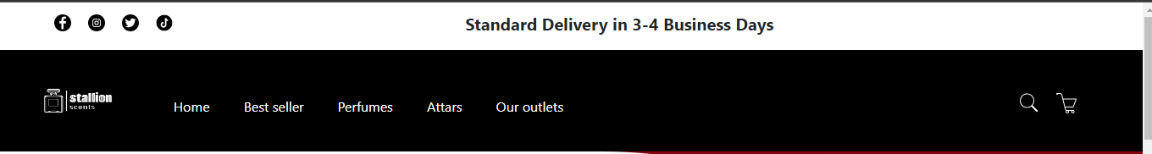
HEADER
Features
Social media links
Message line
Navigation bar

Slide 5

Banner
Features
Visualization
Shop now button

Slide 6
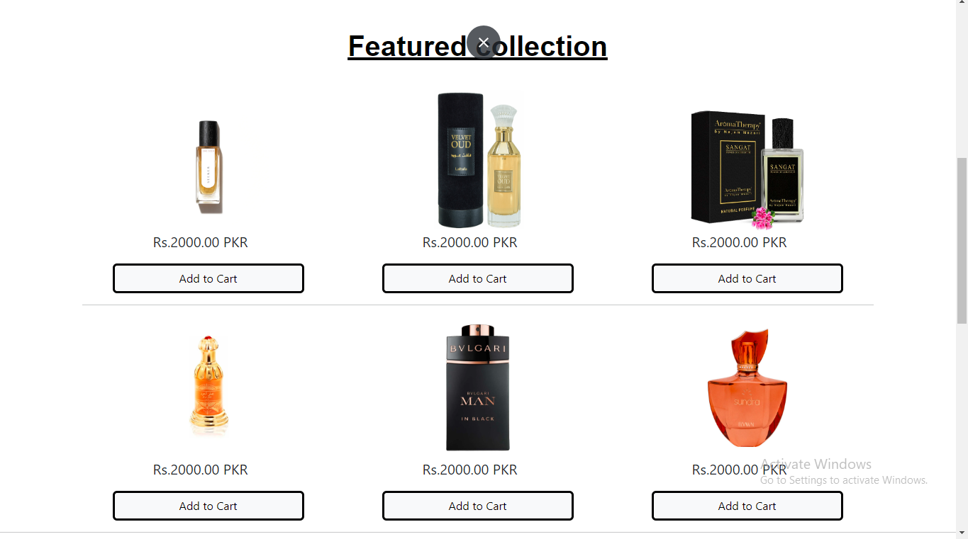
Featured collection

Slide 7
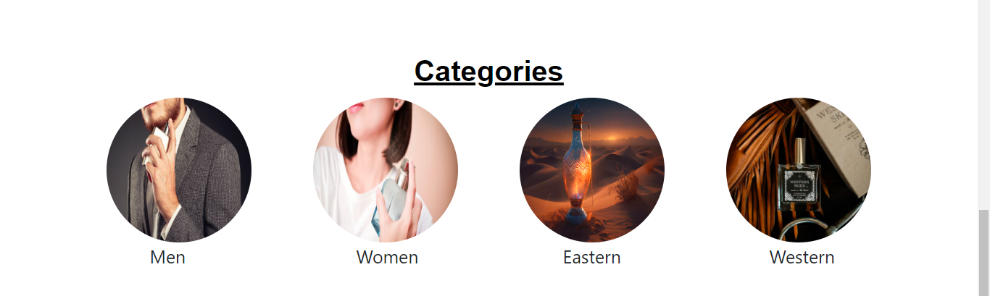
Categories

Slide 8
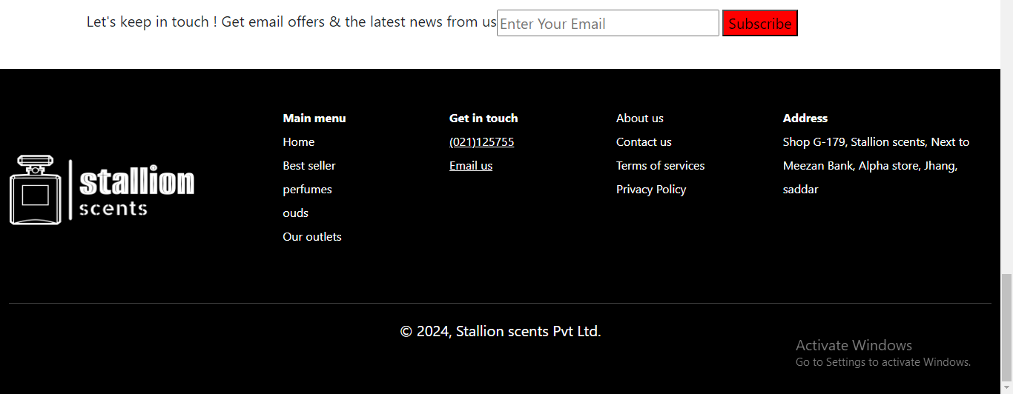
Footer
Include links of different web pages for further information about Brand and website

Slide 9
THANK YOU

